Slide 1

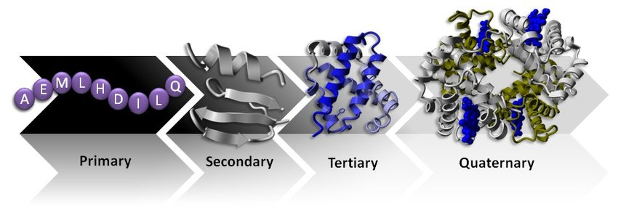
Proteins – biological macromolecules

Slide 2
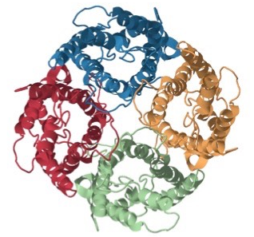
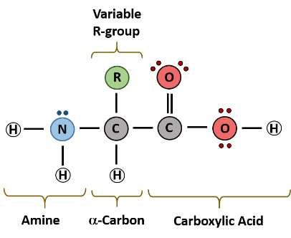
Review – amino acids
Alpha-amino acids contain:
An amino group –NH₂
A carboxylic acid group –CO²H
A variable R group attached to the alpha-carbon
Using the data booklet find the name and abbreviation for the following:
R = H
R = CH₃
R = CH₃SH
R = CH₂CH₂COOH
Glycine Gly
Alanine Ala
Cysteine Cys
Glutamic acid Glu

Slide 3
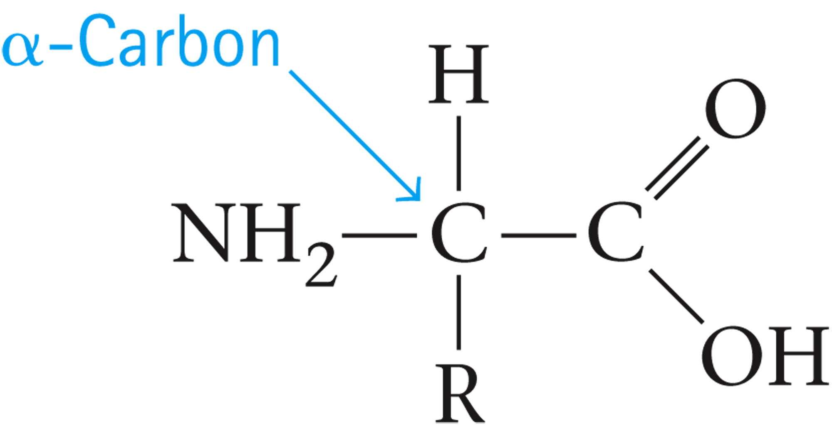
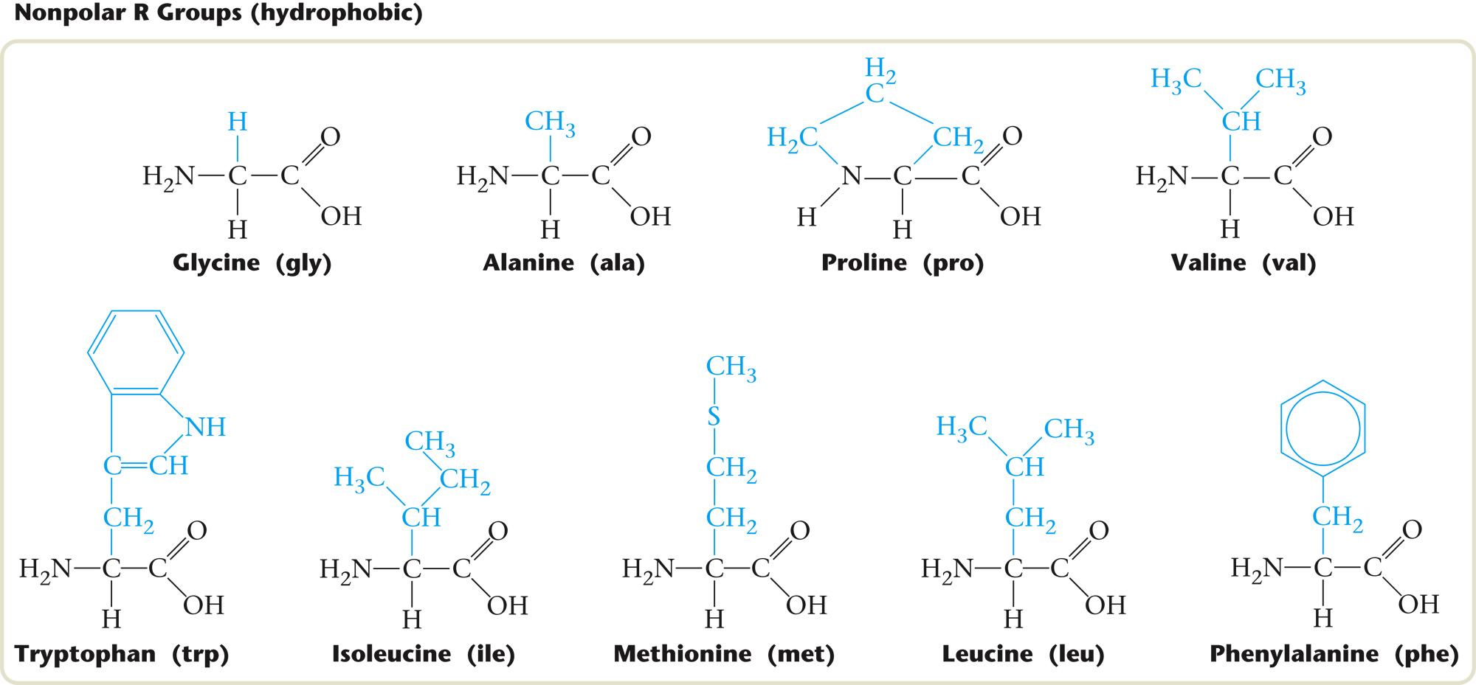
Review – amino acids

Slide 4
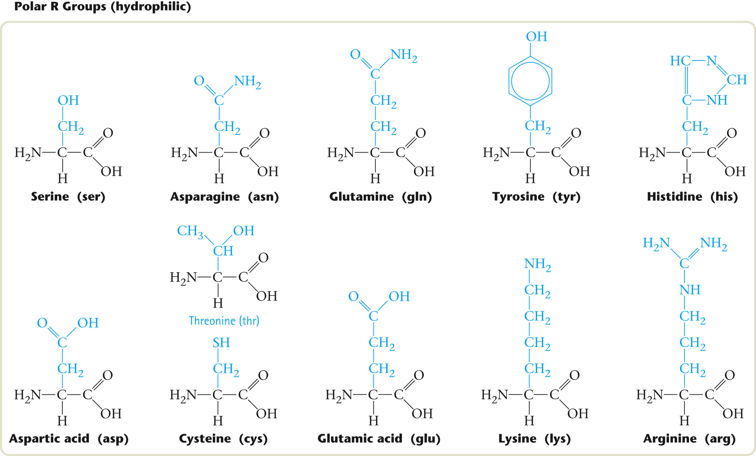
Review – amino acids

Slide 5
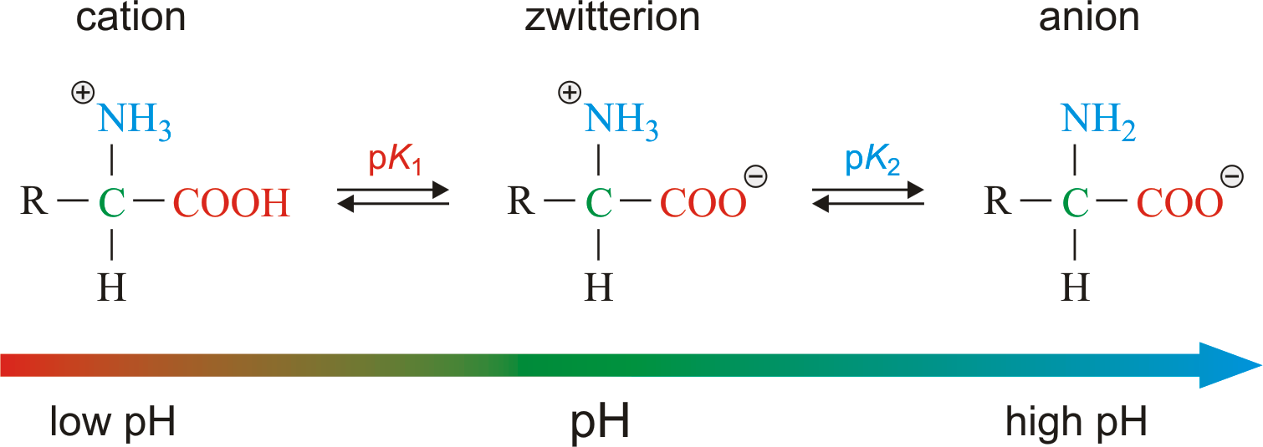
Review – amino acids
Acid base behaviour of amino acids ….
amino acids can act as acids and bases
Depending on the pH of the surroundings they can be a mono-cation, a mono-anion or a zwitterion:

Slide 6
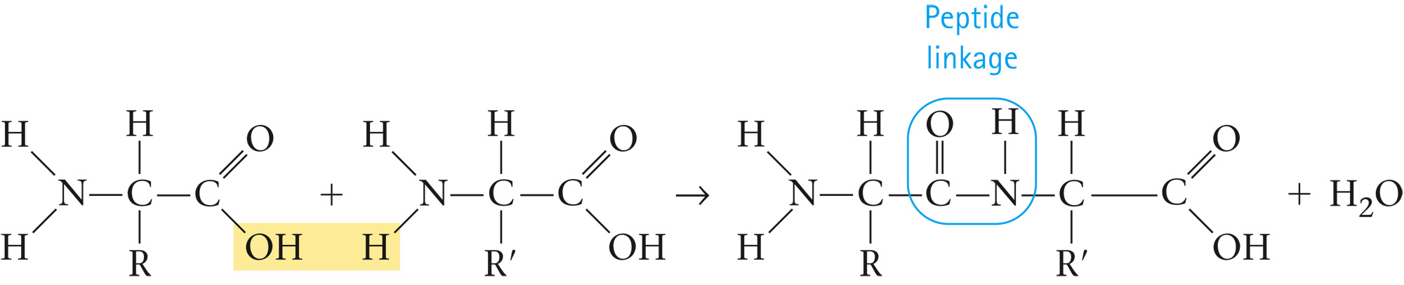
Polymerisation of alpha-amino acids
Alpha-amino acids can undergo condensation polymerisation.
The amine end of one amino acid reacts with the carboxylic acid end of another, forming an amide link that we call a peptide bond.
Water is also formed in the reaction, one water per peptide bond.

Slide 7
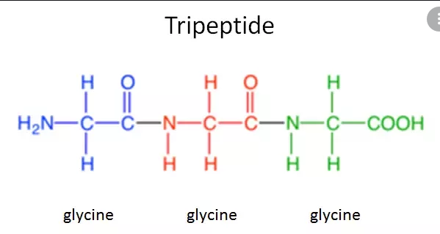
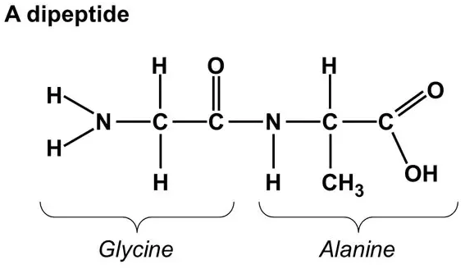
Peptides
A peptide is a short chain of linked amino acids
Naming: Gly-Ala Gly-Gly-Gly
**Naming starts at the N-terminus**

Slide 8
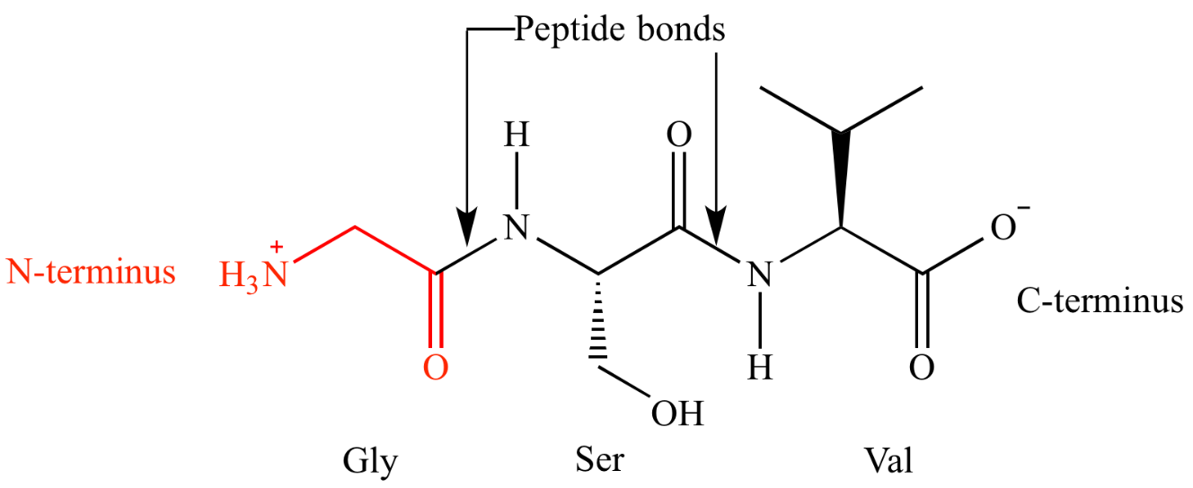
Peptides
Peptides and proteins have ends:
Amino terminus: The end of a protein whose amino acid has not condensed with a carboxyl group (also called N-terminus).
Carboxyl terminus: the end of a protein whose carboxyl group has not undergone condensation (also called C-terminus).

Slide 9
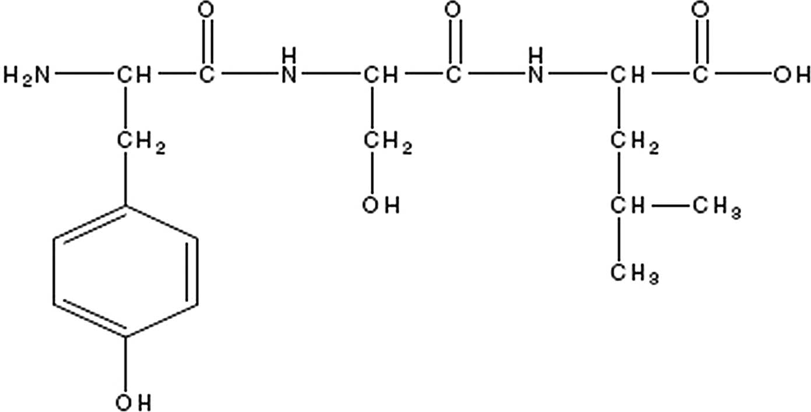
Peptides – naming practice
Practice Question: Use the chemical data sheet for Year 12 WACE to identify the primary structure (sequence).

Slide 10
Peptides – naming practice
Practice Question: Use the chemical data sheet for Year 12 WACE to identify the primary structure (sequence).
C-terminus
N-terminus

Slide 11
Peptides – naming practice
Practice Question: Use the chemical data sheet for Year 12 WACE to identify the primary structure (sequence).
Ser
Leu
Name: Tyr – Ser – Leu
Tyr

Slide 12
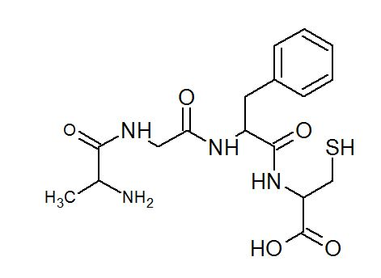
Peptides – naming practice

Slide 13
Peptides – naming practice
Red – α-carbon R= CH₃
Name: Ala
Blue – α-carbon R= CH₂(C₆H₆)
Name: Phe
Green – α-carbon R= H
Name: Gly
Purple – α-carbon R= CH₂SH
Name: Cys
Name: Ala – Gly – Phe - Cys

Slide 14
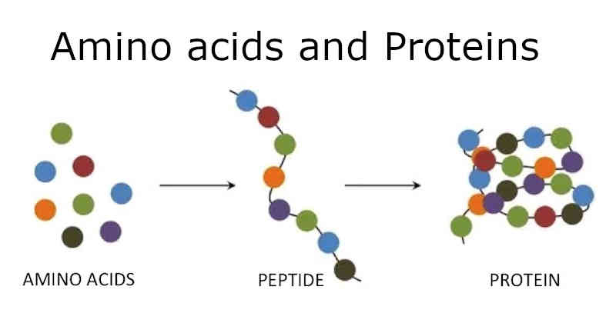
Proteins
A protein is a polymer of alpha-amino acids, generally 50 amino acids and above (there is no exact number but 50)

Slide 15
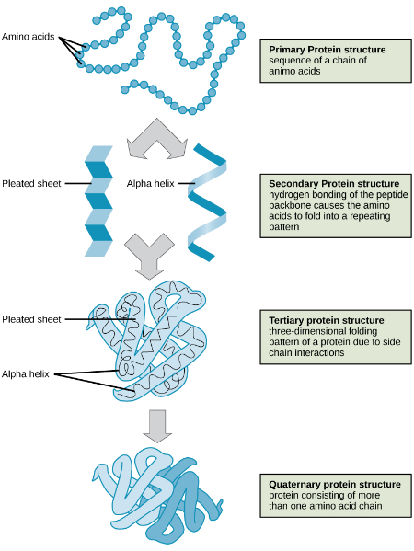
Proteins - structure
Hierarchy of protein structure
Primary Structure is set by the order of the amino acids in the protein polymer chain (due to covalent bonding)
Secondary structure is determined by hydrogen bonding within a protein polymer chain, between the oxygen and nitrogen atoms of the peptide bonds
Tertiary structure is determined by a range of intermolecular forces including hydrogen bonding, dipole-dipole interaction, disulphide bridges and ionic bonding.

Slide 16
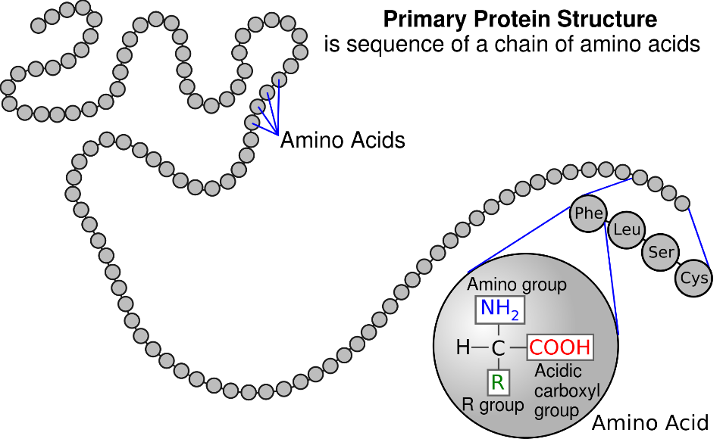
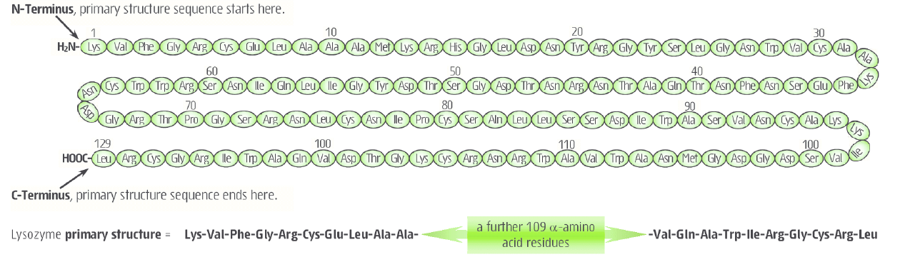
Primary structure
The sequence of amino acids. This is coded for in DNA in living systems. The sequence uses the three letter codes for each amino acid
The bonds involved are the covalent bonds in the peptide (amide) bonds between amino acid residues. This fixes the order of the amino acid residues.
The Primary sequence is always listed from the N-terminus to the C-terminus

Slide 17
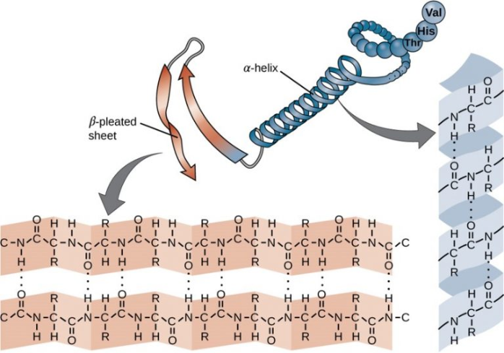
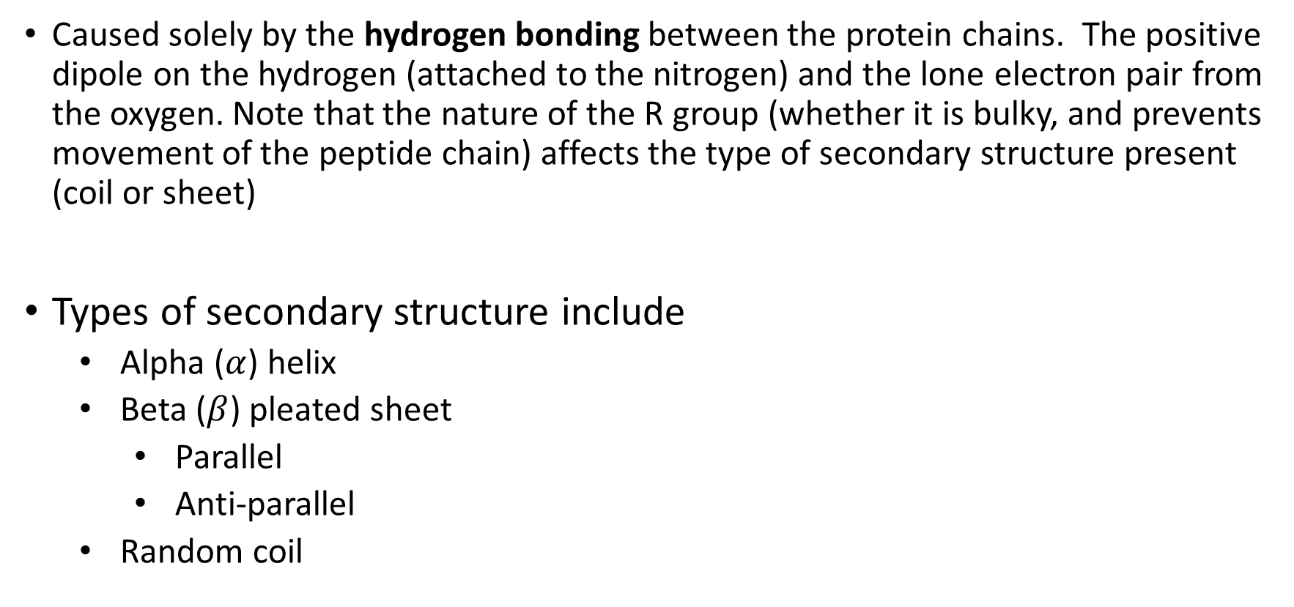
Secondary structure
Caused solely by the hydrogen bonding between the protein chains. The positive dipole on the hydrogen (attached to the nitrogen) and the lone electron pair from the oxygen. Note that the nature of the R group (whether it is bulky, and prevents movement of the peptide chain) affects the type of secondary structure present (coil or sheet)
Types of secondary structure include
Alpha ($α$) helix
Beta ($β$) pleated sheet
Parallel
Anti-parallel
Random coil

Slide 18
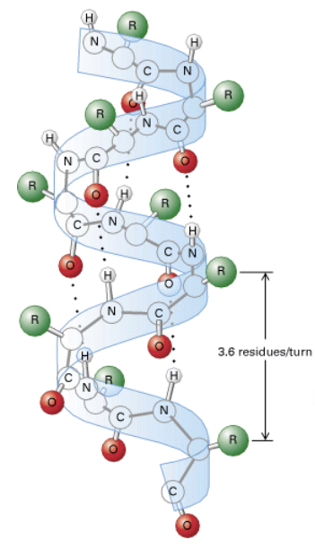
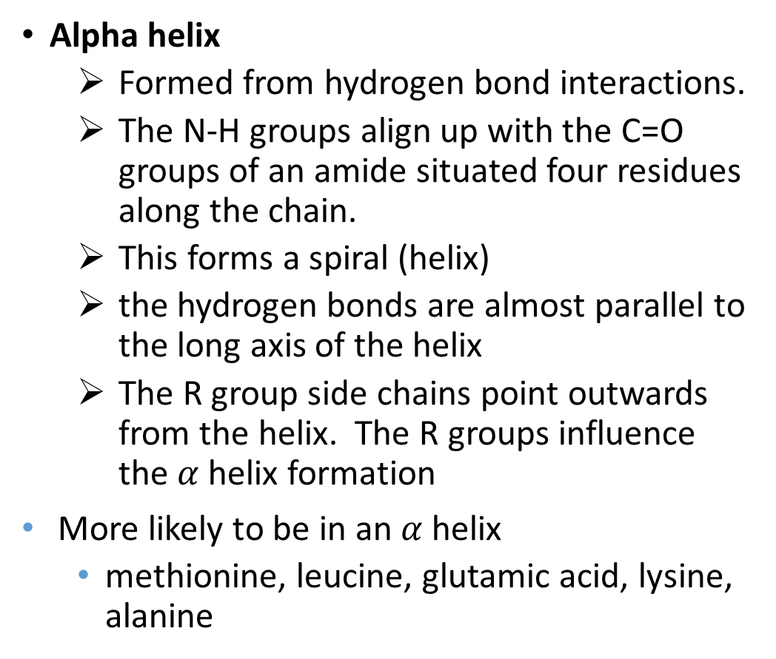
Alpha helix
Alpha helix
Formed from hydrogen bond interactions.
The N-H groups align up with the C=O groups of an amide situated four residues along the chain.
This forms a spiral (helix)
the hydrogen bonds are almost parallel to the long axis of the helix
The R group side chains point outwards from the helix. The R groups influence the $α$ helix formation
More likely to be in an $α$ helix
methionine, leucine, glutamic acid, lysine, alanine

Slide 19
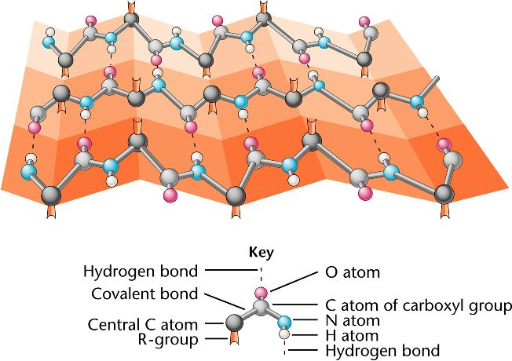
Beta sheets
Beta pleated sheet
Occurs when two adjacent peptide chains line up to allow hydrogen bonding between them.
Note that hydrogens and oxygens on ‘R’ groups do not participate in beta sheet formation – they are in the wrong geometric plane to do this.
R groups alternate between pointing up or down and cause a fold in the sheet
More likely to be in a b-sheet
tryptophan, tryrosine, phenylalanine, valine, isoleucine, threonine

Slide 20
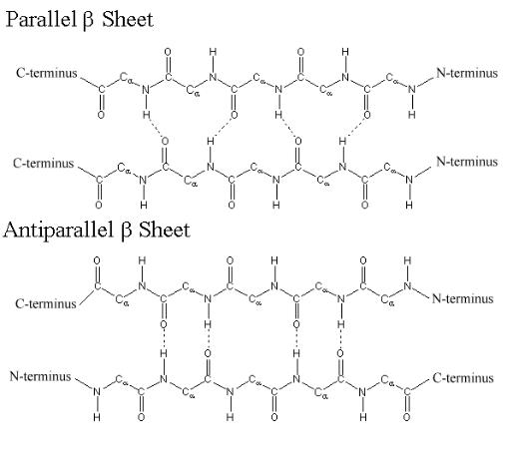
Beta sheets
Beta pleated sheet
Two forms of beta sheet are possible:
Parallel, where the adjacent chains have the C to N terminus in the same direction. This causes the hydrogen bonds to zig-zag
Antiparallel, where the adjacent chains have the C to N terminus are in the opposite direction. This allows the hydrogen bonds to line up. Due to less stress on the hydrogen bonds, antiparallel are more stable (and more common)

Slide 21
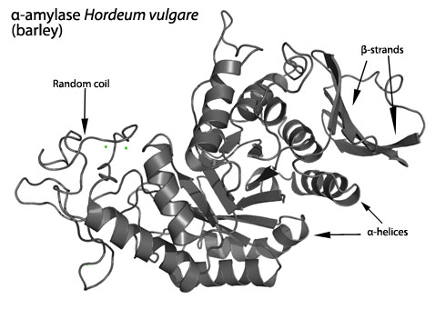
Random coils
“No” secondary structure – no hydrogen bonds!

Slide 22
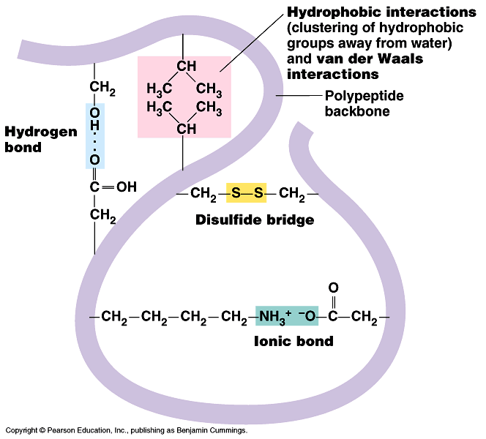
Tertiary structure
It is determined by interactions between side chains of the amino acid residues.
Several different types:
Dispersion forces(hydrophobic interactions)
Hydrogen bonds
ionic (salt bridges)
covalent bonding (disulfide bridges between cysteine residues)

Slide 23
Tertiary structure
Hydrophobic interactions
Non-polar side groups clump together, just as oil does when in water by dispersion forces.
Hydrogen bonds,
Interactions between groups that have –OH, -COOH or –NH₂ Particularly between basic amino acids (those with an amine group in their side chains (eg lysine) and those with an oxygen (eg serine)
Salt bridges
Interactions between amino acids with carboxylate side chains (eg glutamate) and those with amine groups (eg lysine). Salt bridges consist of both electrostatic interactions (-ve charged oxygen with +ve charged nitrogen) and hydrogen bonding between the oxygen and the hydrogen on the amine. pH strongly determines ionisation and hence stability of salt bridges.

Slide 24
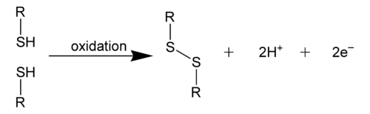
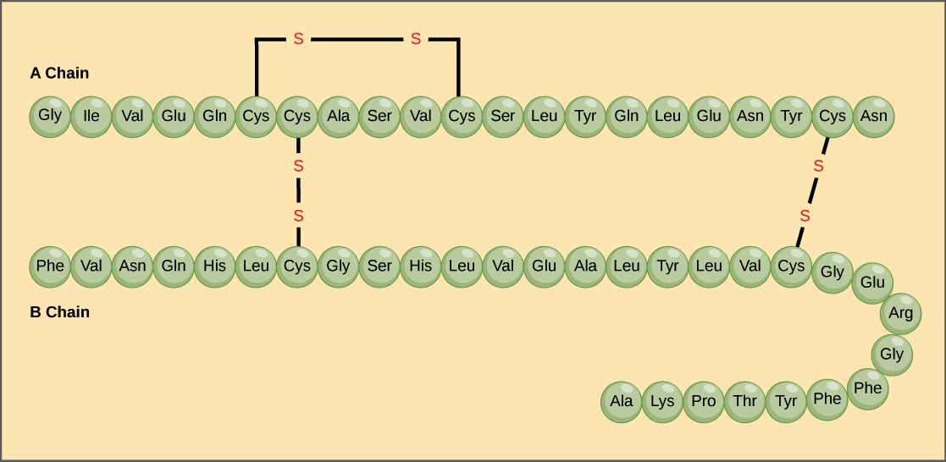
Tertiary structure
Disulfide bridges
Formed by the oxidation of the thiol groups in two cysteine residues
A strong, covalent bond.

Slide 25
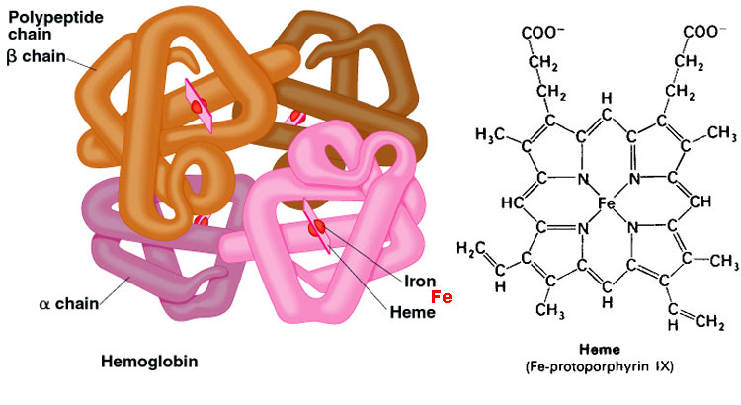
Quaternary structure
You don’t need to know but….
Structure due to multiple subunits (protein chains) coming together.
Forms specific shapes (eg enzyme with active site and substrate)
Frequently held together by hydrophobic interaction and hydrogen bonds, but all the forces involved in tertiary structure may be involved

Slide 26
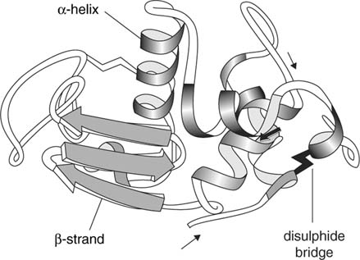
Summary of structure
Type of structure | Bonding or interaction responsible
 | sequence | Hydrogen bonding between amide groups on primary chain | Hydrogen bonds between side groups | Disulphide bridges between cysteine amino acid residues | Ionic bonding between side chains | Dispersion forces between side chains | Dipole-dipole interactions between side groups
primary | X
secondary |  | X
tertiary |  |  | X | X | X | X | X

